Slide 1

Aldrich Public Library
FY 2025 Municipal Request

Slide 2

If trouble viewing video, https://www.youtube.com/watch?v=REhNBfblXi0&t

Slide 3
Rising Costs (Since FY 2021)
Maintenance Costs have increased by 314%
  Signed service contracts for HVAC, Roof, Snow Removal, Cleaning, Elevator Maintenance
  Competitively bid to get the best value
  Previously relied on volunteers that have aged out
Utilities have increased by 33%
9% union wage increases over three years from the Union Contract
Insurance costs have increased by 47%

Slide 4
How Do We Meet The Rising Costs?
Investment transfers have increased by 100% since FY2021
Anticipate increasing our non-resident fee
Budgeting $95,000 in fundraising and donations
Budgeting $12,000 in user fees
Actively pursuing grant funding opportunities
City and Town Appropriations (below state average)

Slide 5
What We Are Asking For
We are requesting $250,170
This is level-funded from last year
Average of $29.67 per resident
State average cost per resident for libraries serving 5,000+ residents is $41.97

Slide 6
Where We’re At
Under current budget proposal, projecting a $30,702 deficit
Recognize the City of Barre’s tough financial situation
Continue our strong partnership with the City and community
Looking forward to future conversations about the growth of the library

Slide 7
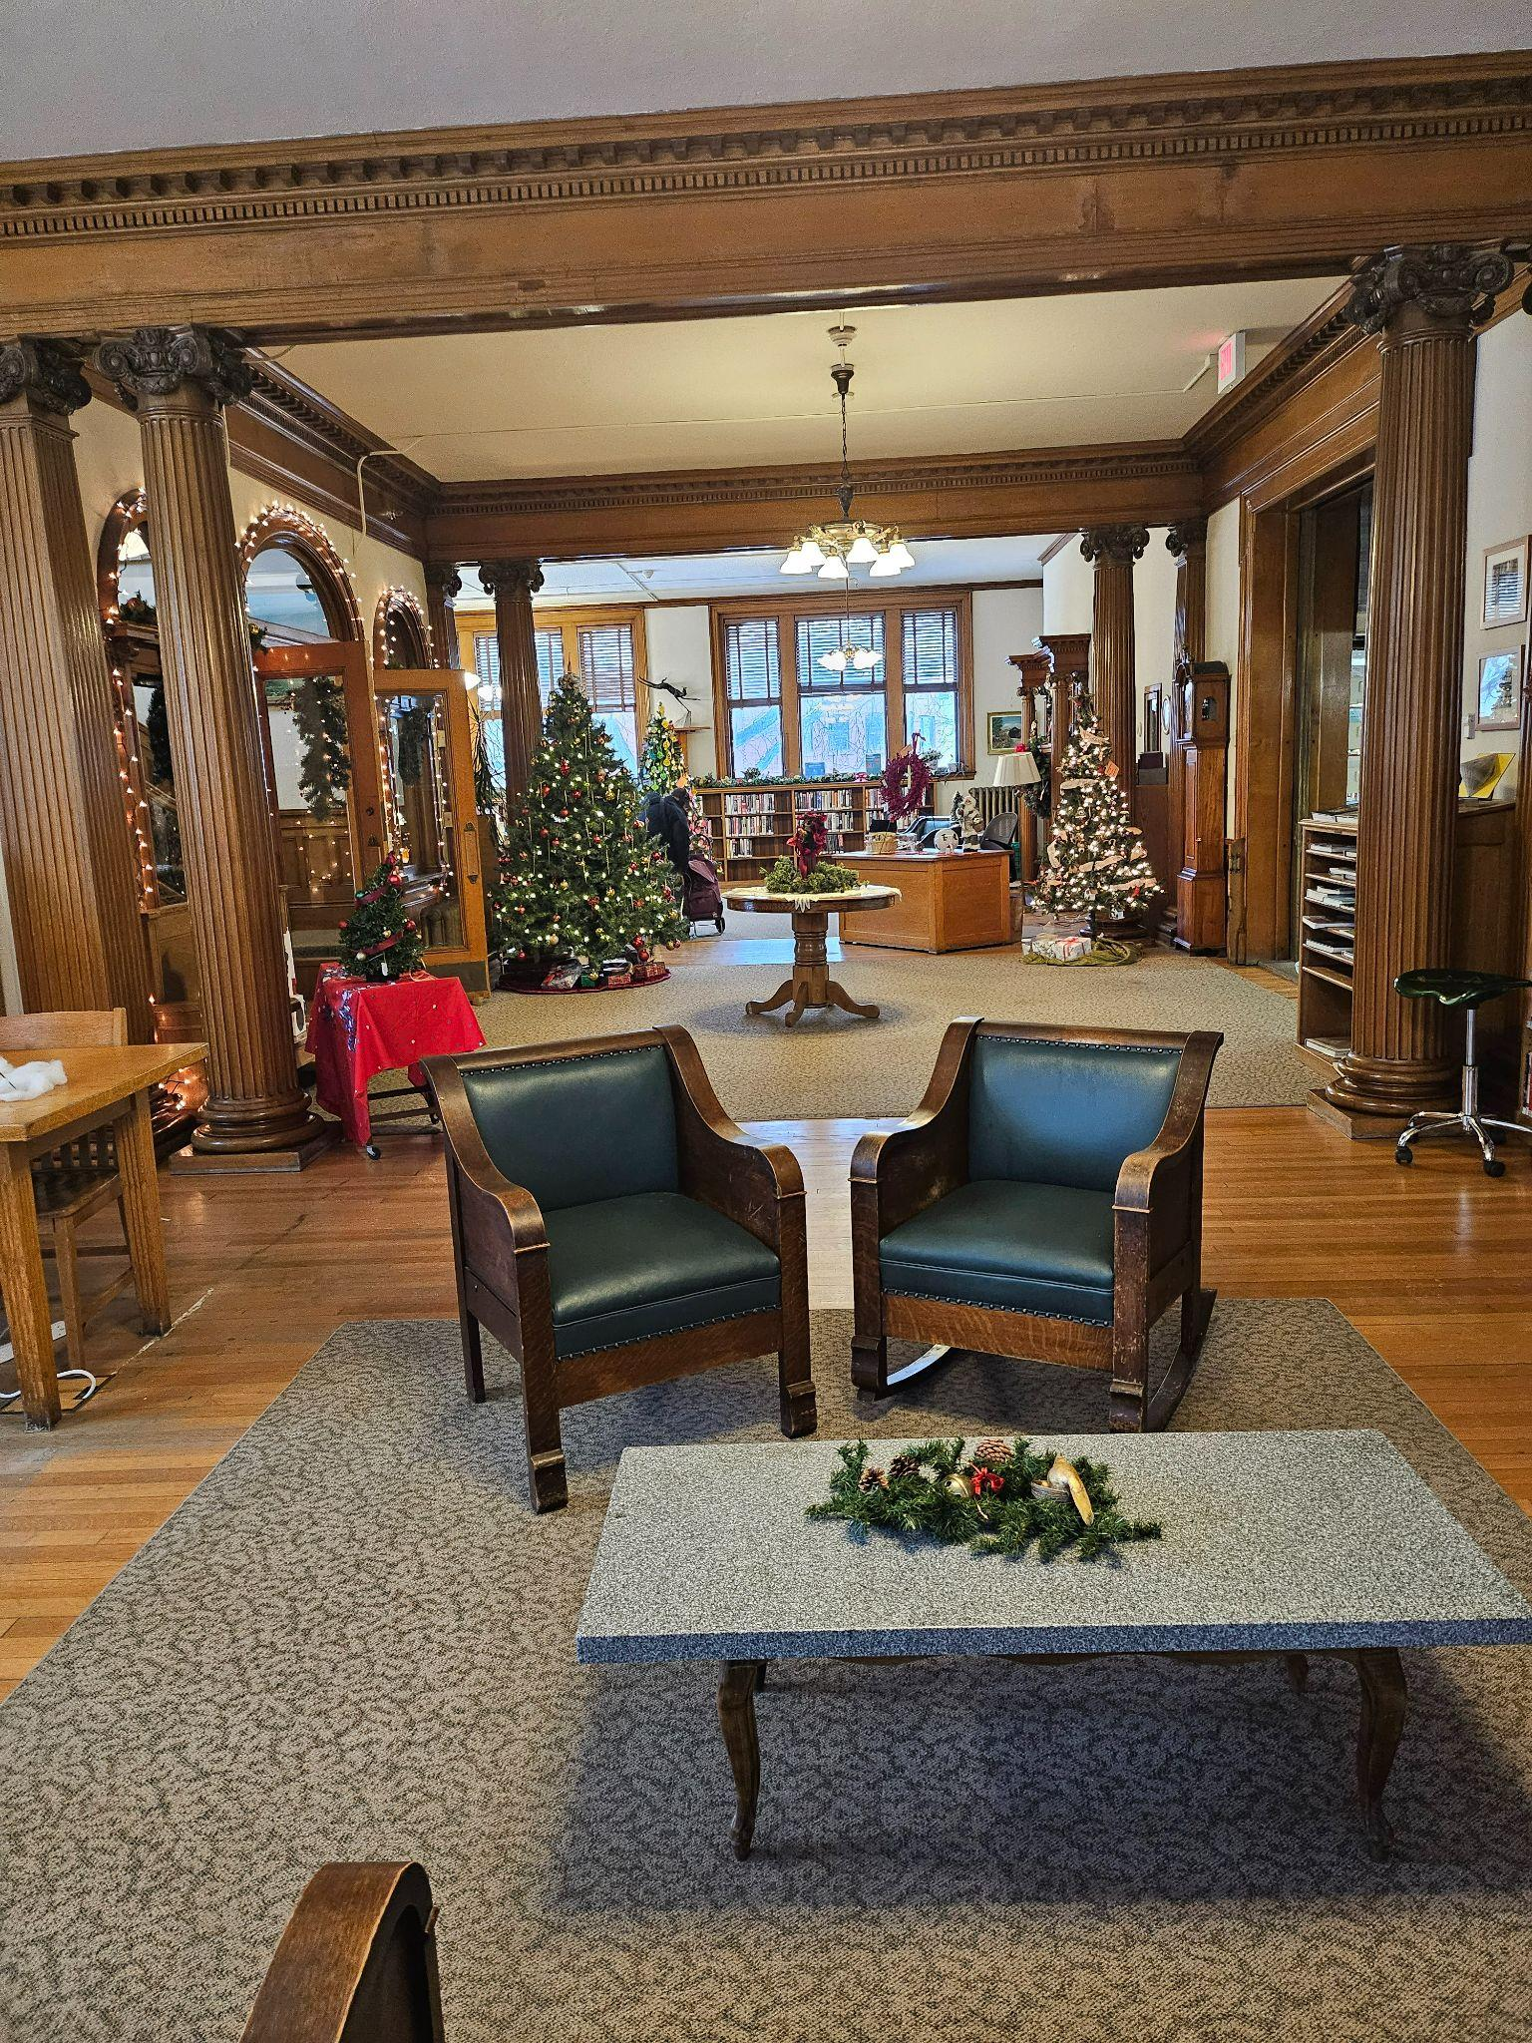

THANK
YOU!

