Slide 1
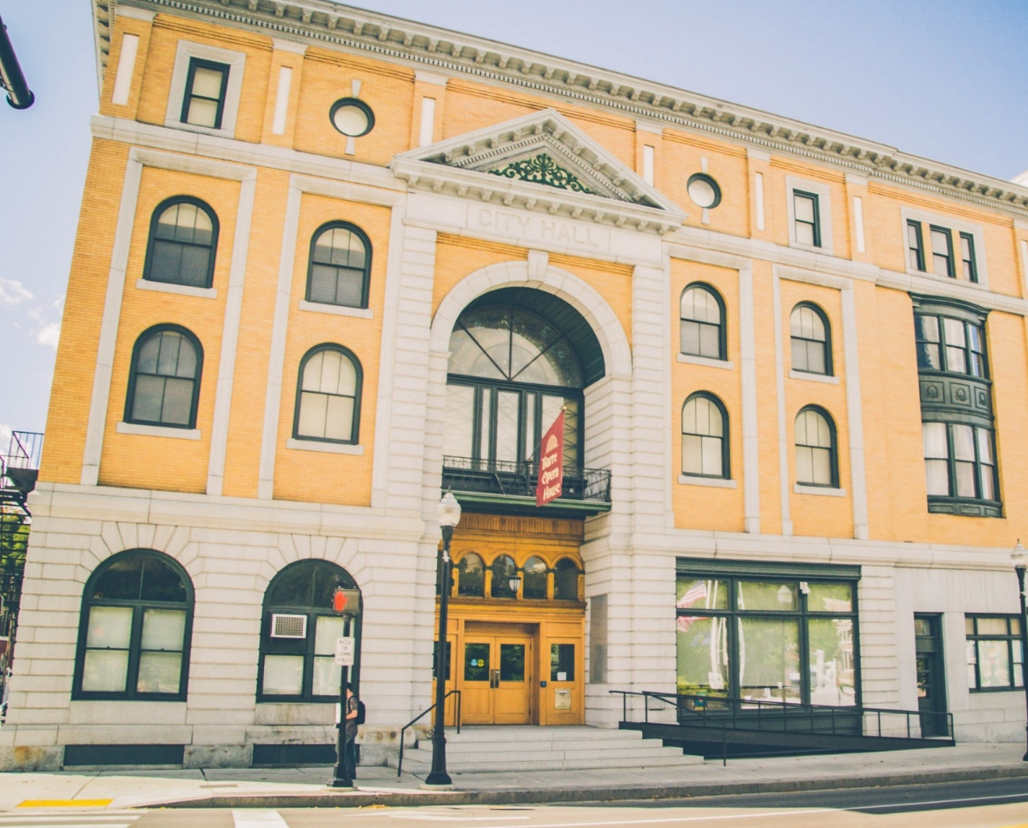
Approved By the Barre City Council on January 28, 2020
CITY OF BARRE, VERMONT
GENERAL FUND BUDGET
FOR THE
YEAR ENDING
JUNE 30, 2021

Slide 2
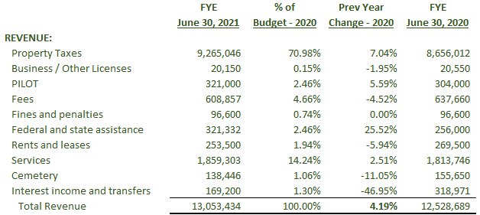
CITY OF BARRE, VERMONT
GENERAL FUND BUDGET COMPARISON SUMMARY
FOR THE FISCAL YEAR ENDING JUNE 30, 2021 AND 2020

Slide 3
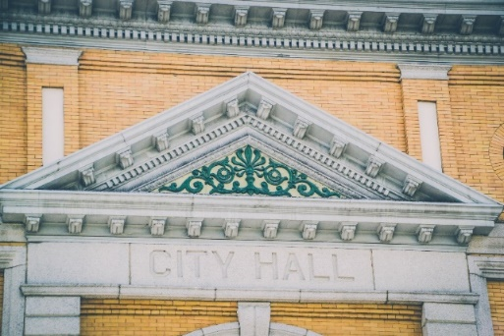
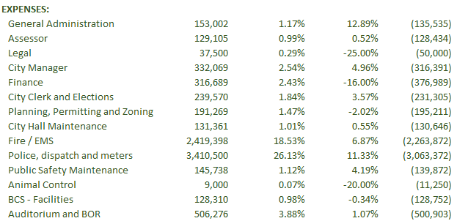
CITY OF BARRE, VERMONT
GENERAL FUND BUDGET COMPARISON SUMMARY
FOR THE FISCAL YEAR ENDING JUNE 30, 2021 AND 2020
Sheet 1 of 2

Slide 4
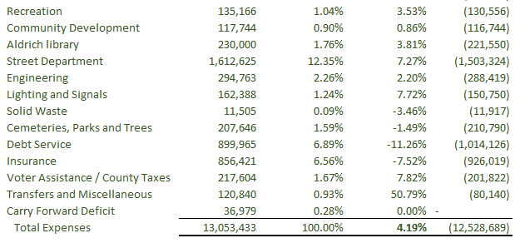
CITY OF BARRE, VERMONT
GENERAL FUND BUDGET COMPARISON SUMMARY
FOR THE FISCAL YEAR ENDING JUNE 30, 2021 AND 2020
Sheet 2 of 2

Slide 5
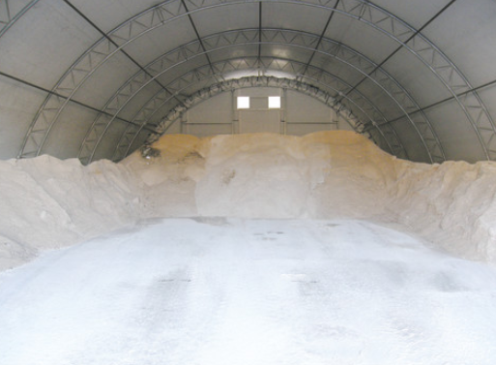
CITY OF BARRE, VERMONT
FY21 GENERAL FUND BUDGET HIGHLIGHTS
Sheet 1 of 2

Slide 6
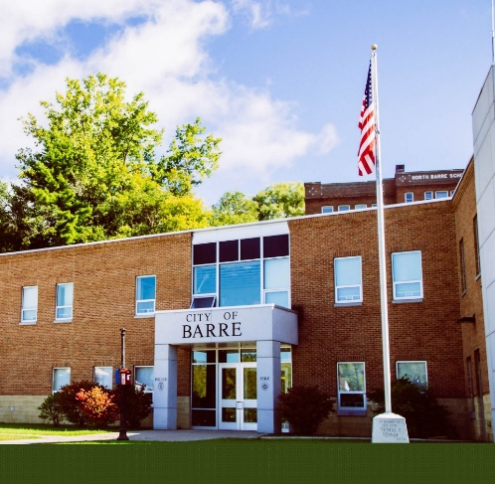
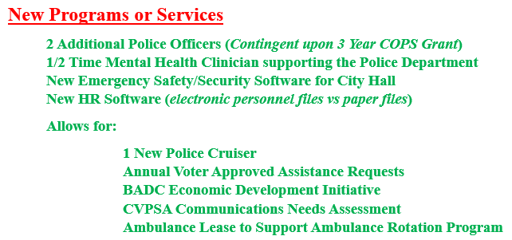
CITY OF BARRE, VERMONT
FY21 GENERAL FUND BUDGET HIGHLIGHTS
Sheet 2 of 2

Slide 7
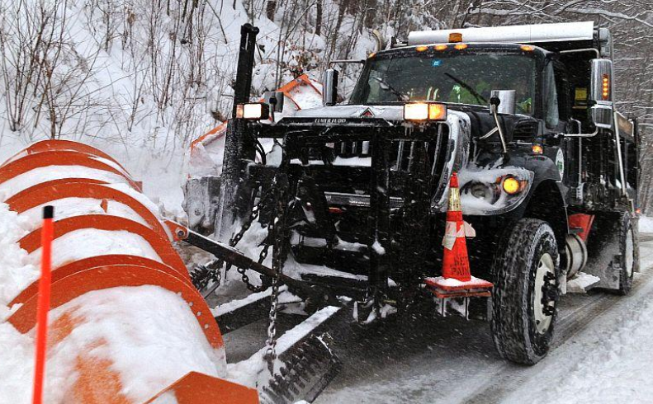
CITY OF BARRE, VERMONT
FY21 BALLOT ITEMS

Slide 8
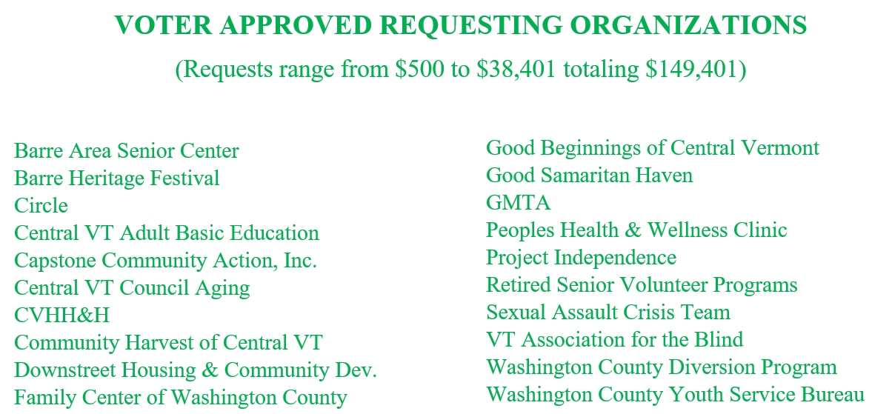
CITY OF BARRE, VERMONT
FY21 BALLOT ITEMS

Slide 9
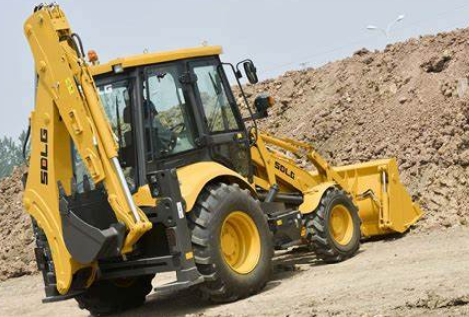
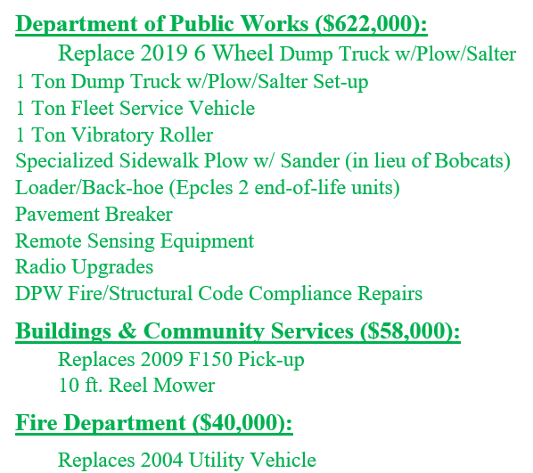
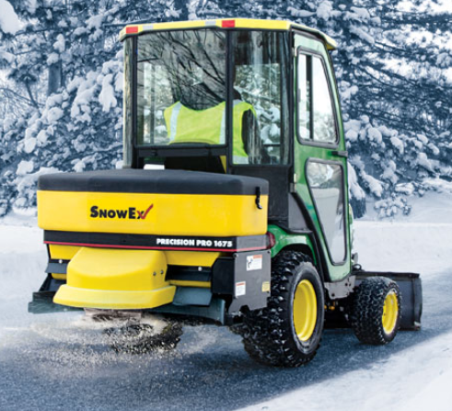
CITY OF BARRE, VERMONT
FY21 BALLOT ITEMS
Sheet 1 of 2

Slide 10
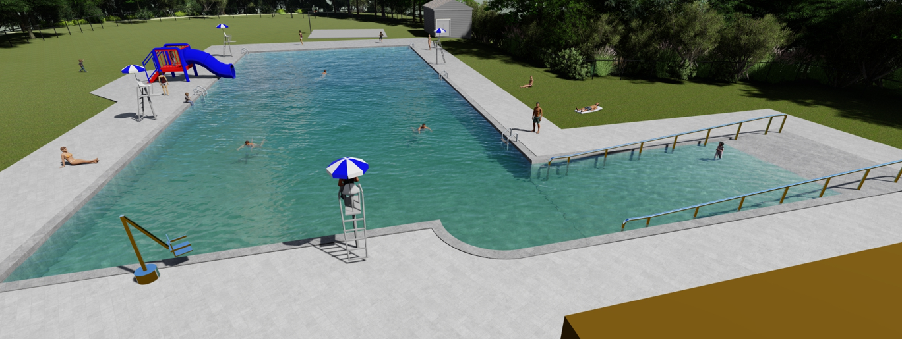
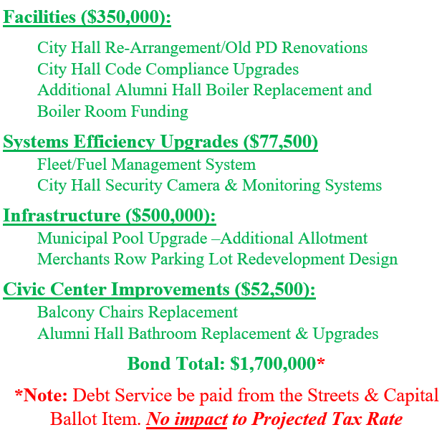
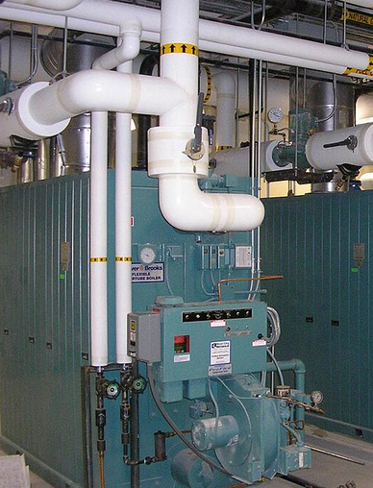
CITY OF BARRE, VERMONT
FY21 BALLOT ITEMS
Sheet 2 of 2

Slide 11
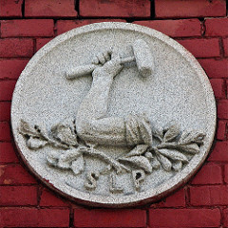
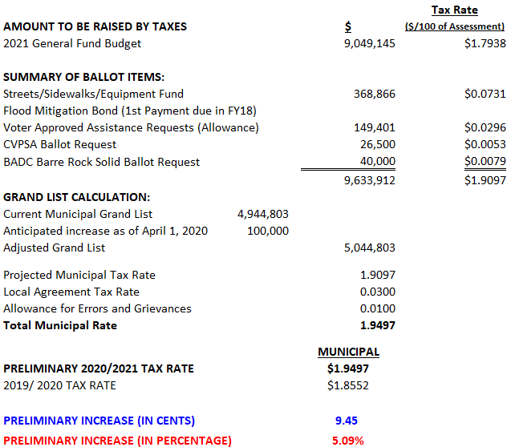
CITY OF BARRE, VERMONT
PROJECTED TAX RATE CALCULATION AND STATISTICS
FOR THE FISCAL YEAR ENDING JUNE 30, 2021

Slide 12
CITY OF BARRE, VERMONT
PROJECTED TAX RATE CALCULATION
FOR THE FISCAL YEAR ENDING JUNE 30, 2021

Slide 13
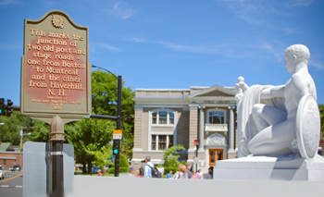
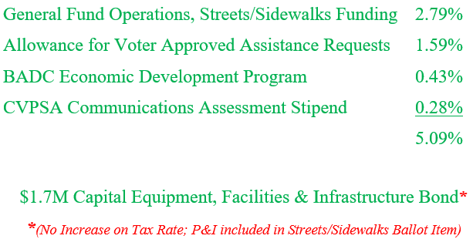
CITY OF BARRE, VERMONT
FY21 GENERAL FUND BUDGET

Slide 14
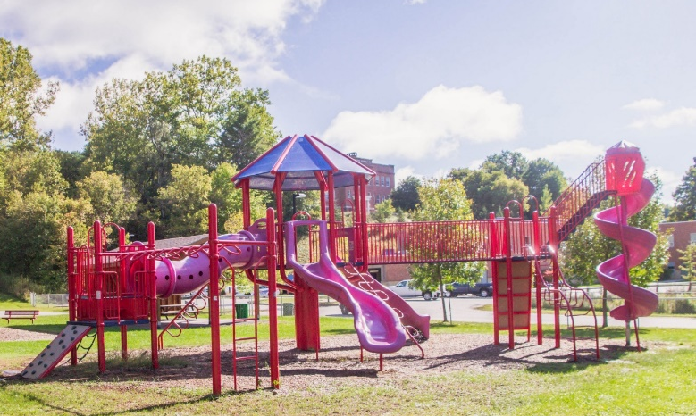
CITY OF BARRE, VERMONT
FY21 GENERAL FUND BUDGET
Budget Proposal is available for review
on the City Website at
https://www.barrecity.org/city-manager
Questions? Call or email the City Manager Steven Mackenzie at
476-0241 or manager@barrecity.org

