Slide 1
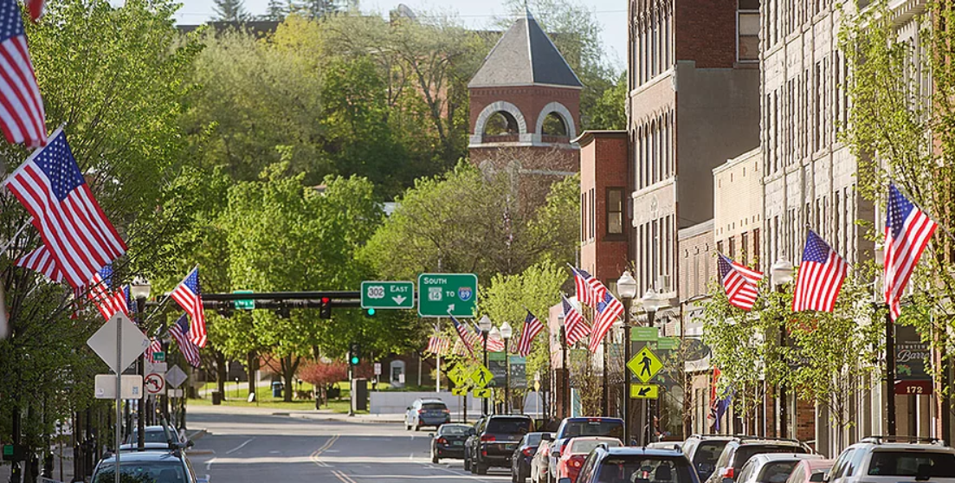
Approved By the Barre City Council on January 19, 2021
City of Barre, VT GENERAL FUND BUDGET
For the Year Ending JUNE 30, 2022

Slide 2
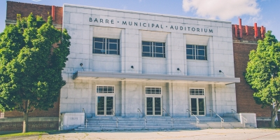
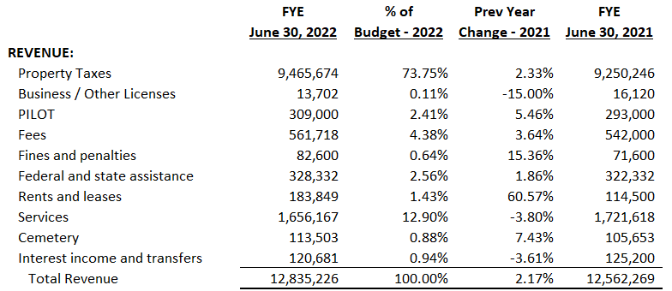
CITY OF BARRE, VERMONT
GENERAL FUND BUDGET COMPARISON SUMMARY
FOR THE FISCAL YEAR ENDING JUNE 30, 2022 AND 2021

Slide 3
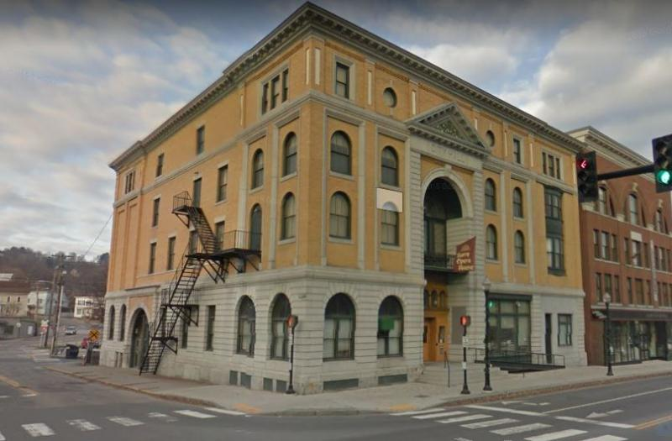
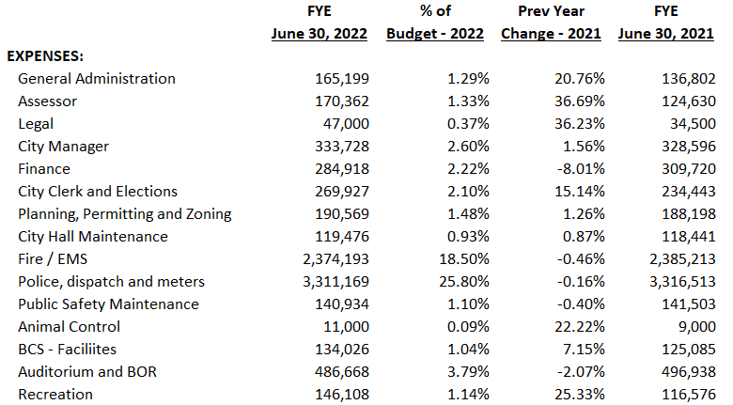
CITY OF BARRE, VERMONT
GENERAL FUND BUDGET COMPARISON SUMMARY
FOR THE FISCAL YEAR ENDING JUNE 30, 2022 AND 2021
Sheet 1 of 2

Slide 4
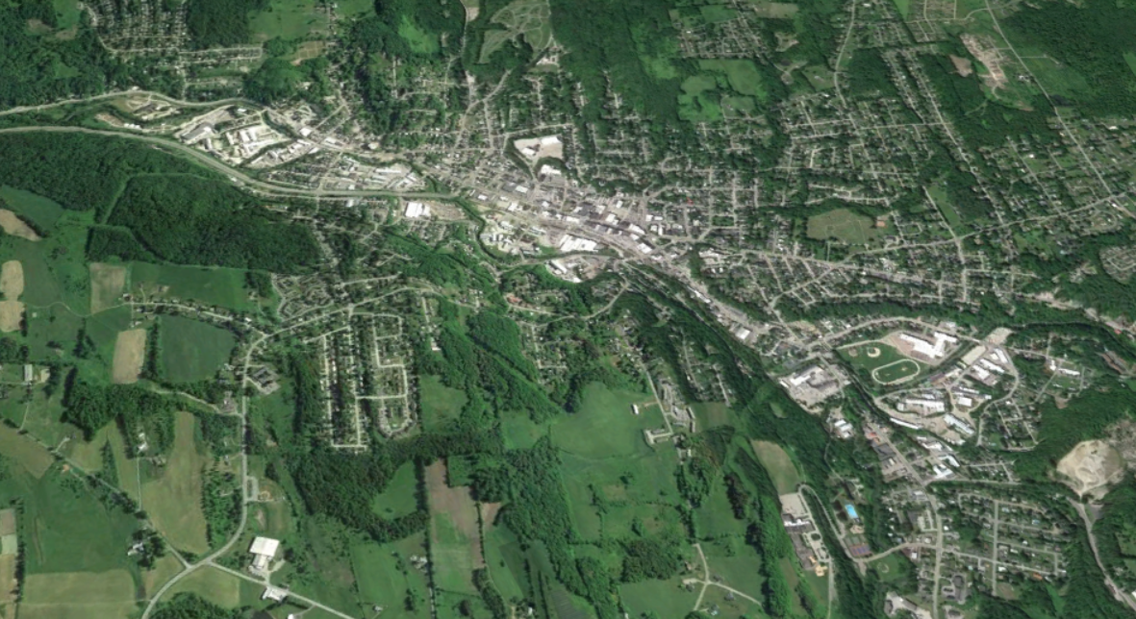
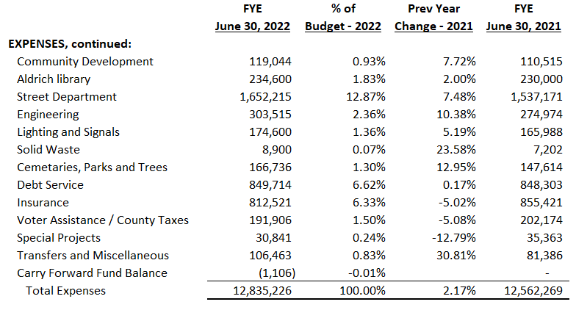
CITY OF BARRE, VERMONT
GENERAL FUND BUDGET COMPARISON SUMMARY
FOR THE FISCAL YEAR ENDING JUNE 30, 2022 AND 2021
Sheet 2 of 2

Slide 5
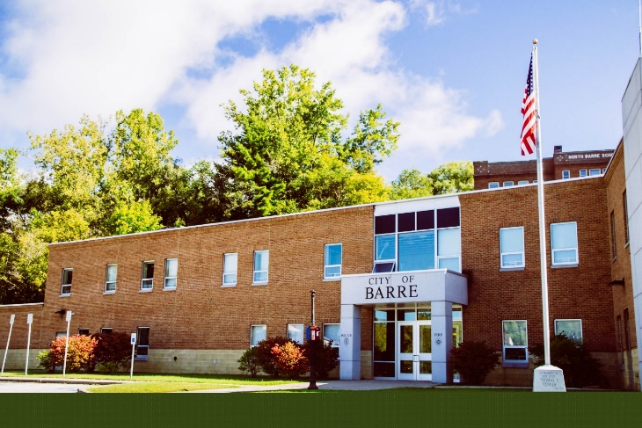
CITY OF BARRE, VERMONT
FY22 GENERAL FUND BUDGET HIGHLIGHTS
Continued Programs & Services:
Annual City Wide Salary and Benefits Adjustments
Health and Related Insurance Renewal
Semi-Annual Yard Waste Collection and Disposal
Community Service Officer
½ Time Mental Health Clinician supporting the Police Department
Police K-9 Program
Police Department Street Crimes Unit (SCU)
Two (2) COPS Grant Police Officers
COVID expenses Allowance
Funding of the Barre Area Development Corp. and The Barre Partnership
Funding of the Aldrich Library
Continued Funding for Annual Facilities Maintenance

Slide 6
CITY OF BARRE, VERMONT
FY22 GENERAL FUND BUDGET HIGHLIGHTS
New Programs & Services:
Full Time Staff Assessor (+ $41,500)
Working Communities Grant Match (+ $5,000)
Interpretive Services Allowance (+ $1,000)
Increased Pool and Summer Camp Staffing (+/- $21,750)
Bulk Waste Removal Event (+/- $17,500)
Partial Restoration of Seasonal Cemetery Staff (+ $20,000)

Slide 7
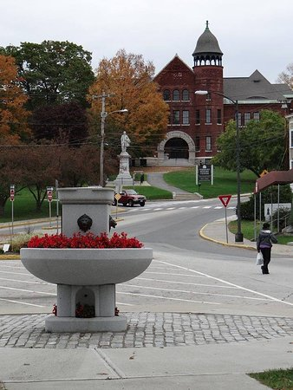
CITY OF BARRE, VERMONT
FY22 BALLOT ITEMS
ADDITIONAL BALLOT ITEMS TO BE VOTED:
Streets, Sidewalks, Equipment Fund $ 380,000
Voter Approved Assistance Requests $ 149,601
No Bond Requests

Slide 8
CITY OF BARRE, VERMONT
FY22 BALLOT ITEMS
VOTER APPROVED REQUESTING ORGANIZATIONS
(22 Requests range from $500 to $38,401 totaling $149,601)
Barre Area Senior Center
Barre Heritage Festival
CIRCLE
Central VT Adult Basic Education
Capstone Community Action, Inc.
Central VT Council on Aging
Central VT Home Health & Hospice
Community Harvest of Central VT
Downstreet Housing & Community Development
Family Center of Washington County
Good Beginnings of Central Vermont
Good Samaritan Haven
GMTA
Our House of Central Vermont
Mosaic Vermont (Formerly Sexual Assault Crisis Team)
Peoples Health & Wellness Clinic
Retired Senior Volunteer Programs
VT Association for the Blind
VT Center for Independent Living
Washington County Diversion Program
Washington County Mental Health
Washington County Youth Service Bureau

Slide 9
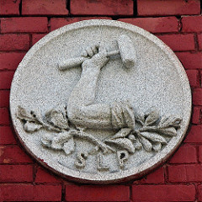
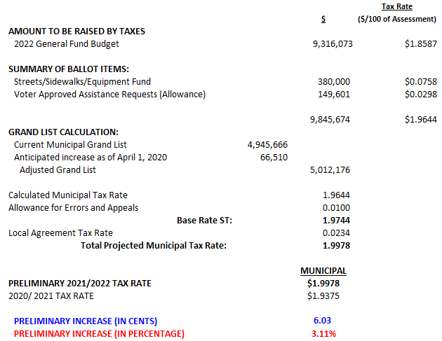
CITY OF BARRE, VERMONT
PROJECTED TAX RATE CALCULATION AND STATISTICS
FOR THE FISCAL YEAR ENDING JUNE 30, 2022

Slide 10
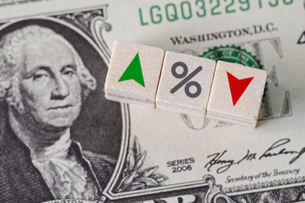
CITY OF BARRE, VERMONT
PROJECTED TAX RATE CALCULATION
FOR THE FISCAL YEAR ENDING JUNE 30, 2022
PROJECTED TAX CHANGE BASED UPON PROPERTY VALUE
Annually Quarterly Monthly
Effect on $125,000 Home $75 $19 $6
Effect on $150,000 Home $90 $23 $8
Effect on $200,000 Home $121 $30 $10

Slide 11
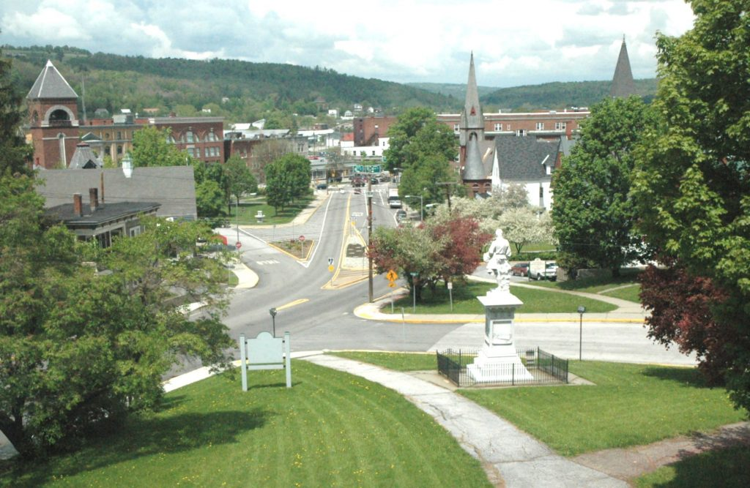
CITY OF BARRE, VERMONT
FY22 GENERAL FUND BUDGET
FY22 EXPENDITURES PERSPECTIVE
FY20 Voter Approved Budget $ 12,528,689
+ $487,766 (+ 3.6%)
FY21 Voter Approved Budget $ 13,016,455
- $454,156 (- 3.5%)
FY21 Revised COVID Budget $ 12,562,269
+ $274,063 (+ 2.18%)
FY22 Budget $12,836,332

Slide 12
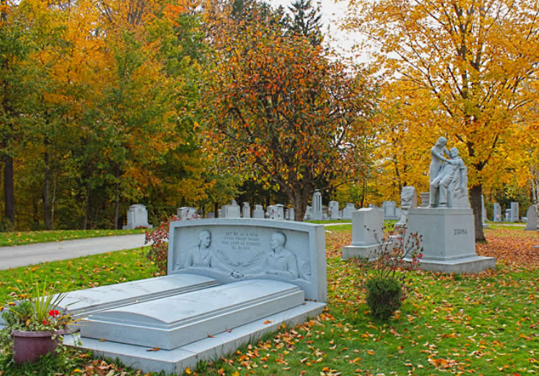
CITY OF BARRE, VERMONT
FY22 GENERAL FUND BUDGET
ANNUAL EXPENDITURES GROWTH: FY20 TO FY22
FY22 $ 12,836,332 2 Years
FY20 $ 12,528,689 = 2.45% = 1.23% per YEAR

Slide 13
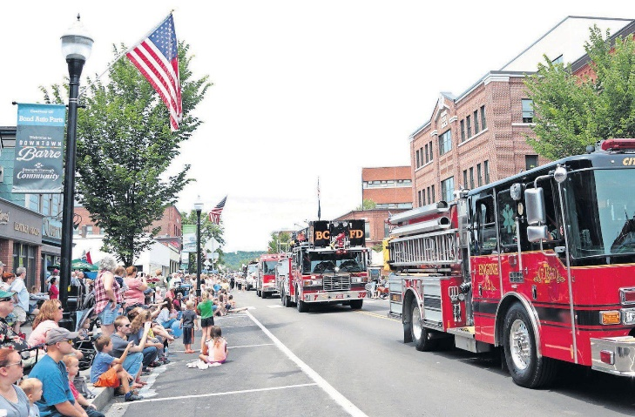
CITY OF BARRE, VERMONT
FY22 GENERAL FUND BUDGET
Budget Proposal is available for review
on the City Website at
https://www.barrecity.org/city-manager
Questions? Call or email the City Manager Steven Mackenzie at
476-0240 or manager@barrecity.org

